Slide 1


Web Scrapping and Exploratory Analysis on Headphones details from

Slide 2
OBJECTIVE
The objective of this project is to automate the extraction of headphones from AMAZON using web scraping and transform it into a structured dataset.
This dataset is then used to perform exploratory data analysis (eda) on key features such as ratings, models, color, type, discounts, and pricing of multiple brands.
The goal is to uncover meaningful patterns, trends, and insights that can inform consumer behavior, brand preferences, and market opportunities in the industry.

Slide 3
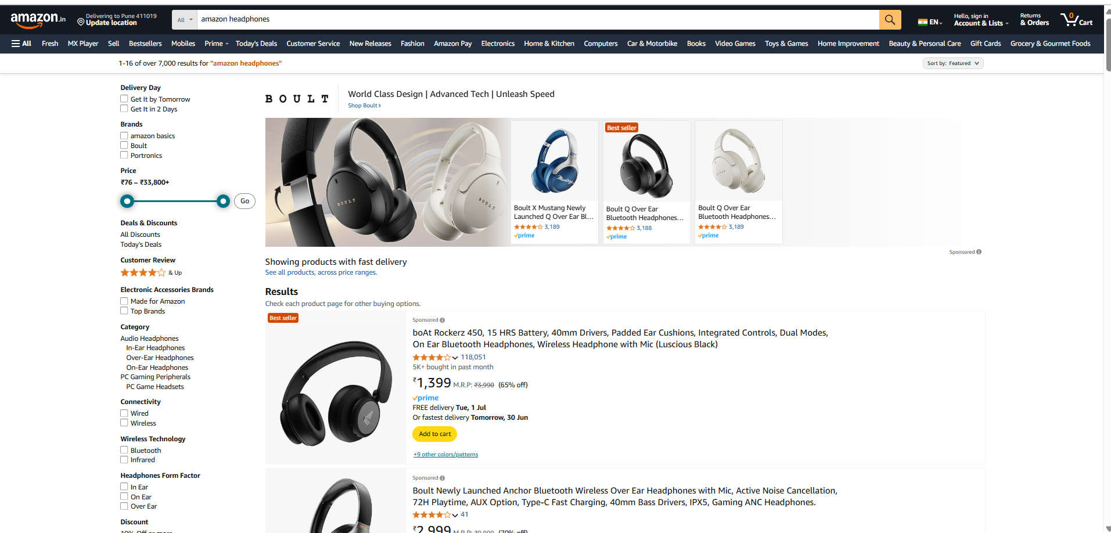
WEBSCRAPPING
The website used for web scrapping and obtained the data from –
https://www.amazon.in/

Slide 4
STEPS TO BE FOLLOWED
Import necessary libraries to perform to extract data from website(beautifulsoup,requests)
Extract the data by sending request to website then using beautiful soup to remove html tags
With the help of regex finding out patterns to get data and then appending it into list,converting it into dataframe to perform futher analysis.

Slide 5
FEATURES EXTRACTED
Brand
Model
Colour
Type
Rating
Counts of ratings
Discounted price
Original price
Brought frequency

Slide 6
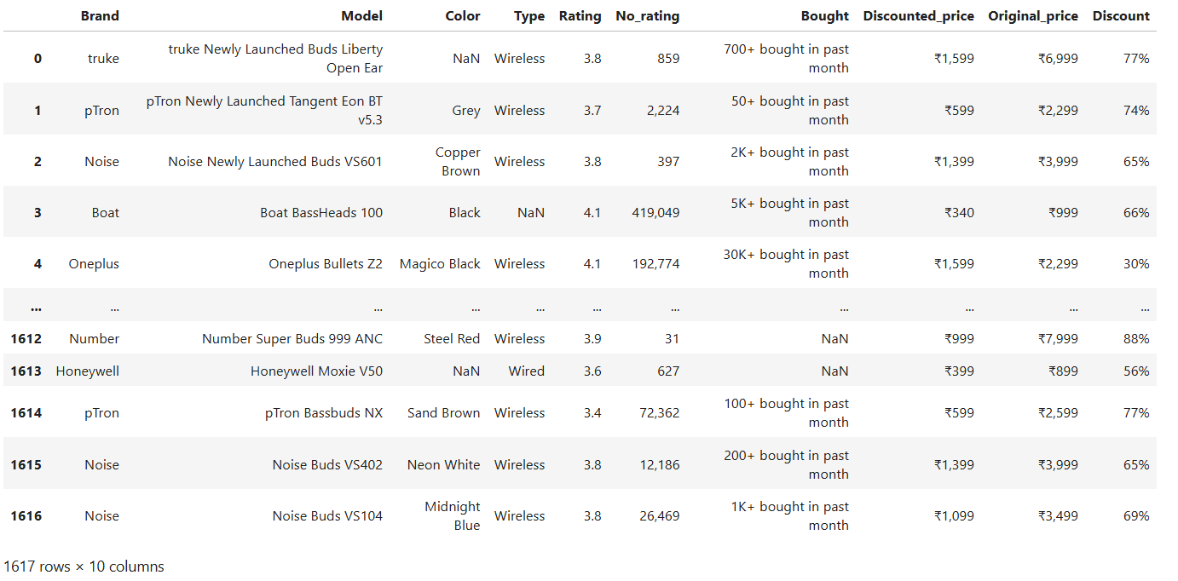
DATA FRAME CREATED

Slide 7
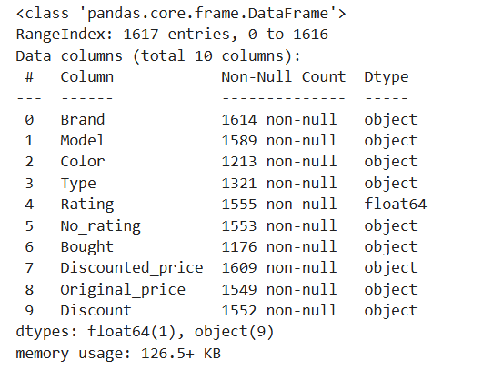
DATA SUMMARY

Slide 8
EXPLORATORY DATA ANALYSIS
Data cleaning
Step1: import all the required libraries to perform EDA on data collected.
Step2: clean the data : in this section you have to clean the data like:
- removing the special characters, incorrect headers
- Incorrect format of the data (invalid values, columns)
- converting the data types
Data manipulation:
Identifying and treatment of the missing values
Identifying and treating the outliers (based on the problem statement or data)
summarize data using statistics (e.g, Average, sum, count).

Slide 9
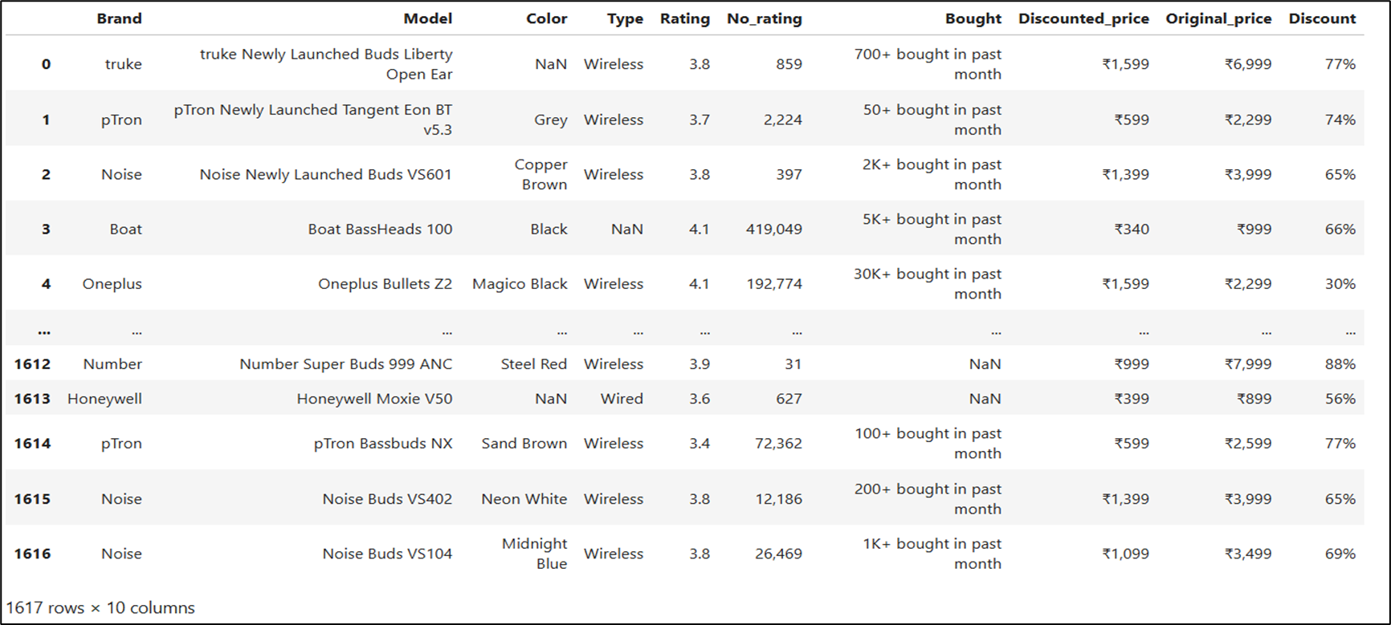
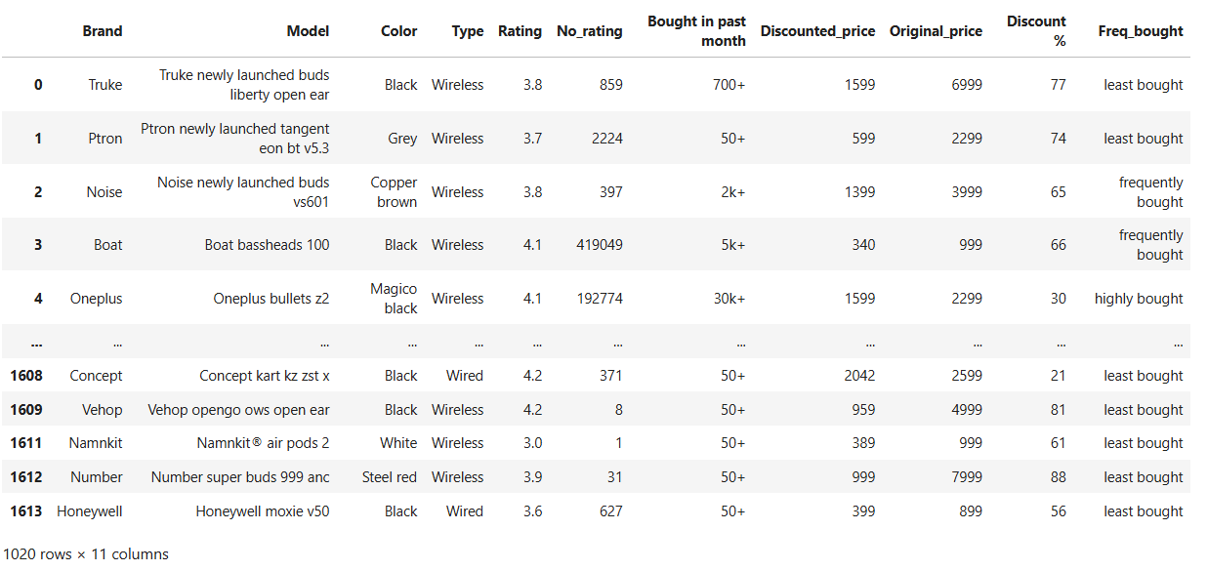
DATA FRAME AFTER DATA CLEANING AND DATA MANIPULATION –

Slide 10
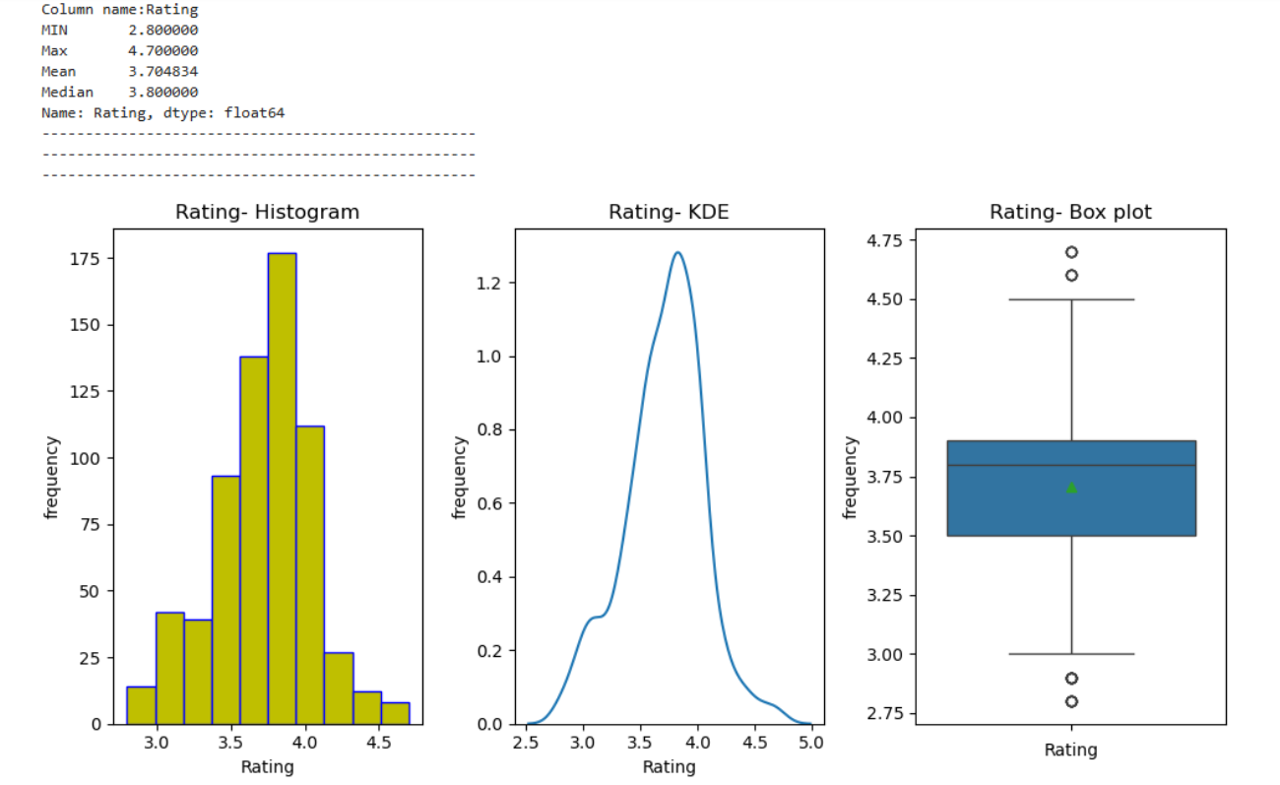
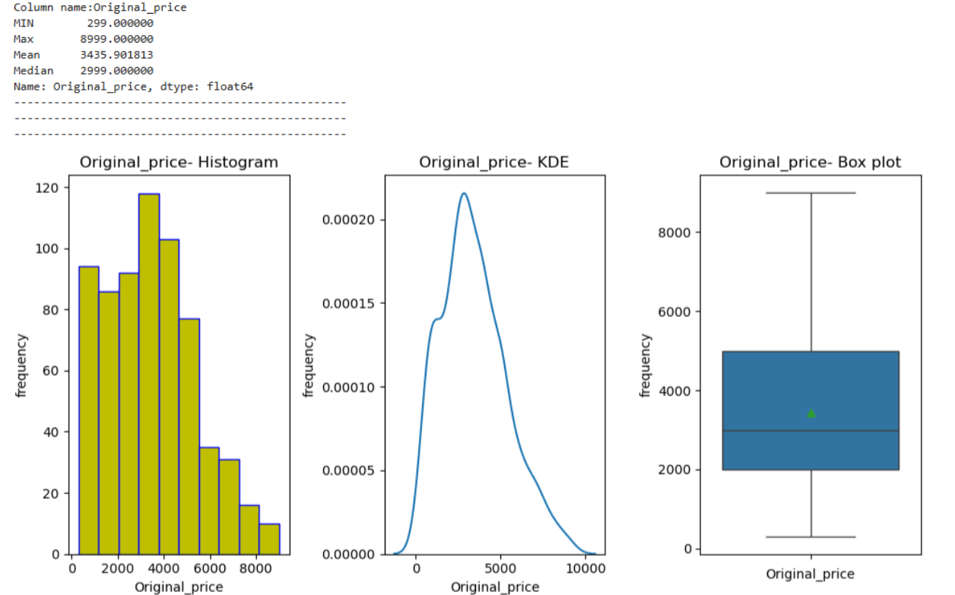
Univariate Analysis on Numerical Cols
Highest number people gaved the rating between 3.5 – 4.2, Max rating 4.7 , Min rating 2.8 ,Avg rating 3.7.
Data is slightly right skewed distribution.
Some outliers are shown towards both end.
Costs of most of the products is in between 290 – 7500 and some products with high costs
Min price – 299 , Max pice - 8999

Slide 11
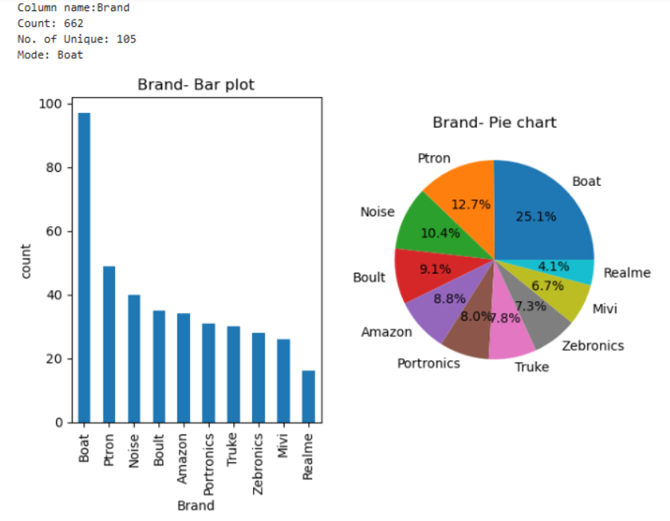
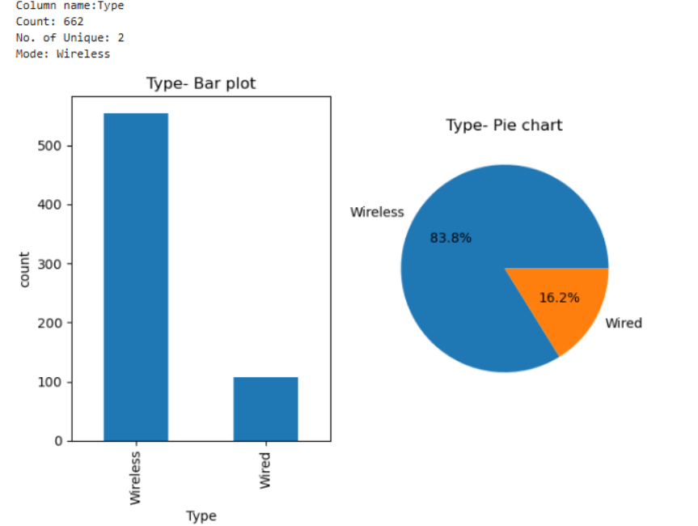
Univariate analysis on categorical cols
Boat is the most popular brand It has the highest number of products
There are 105 unique brands and 662 products
About 84% of the products are wireless and only around 16% of the products are wired among the whole products

Slide 12
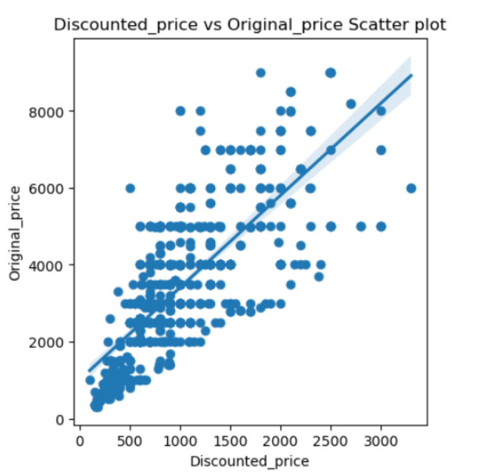
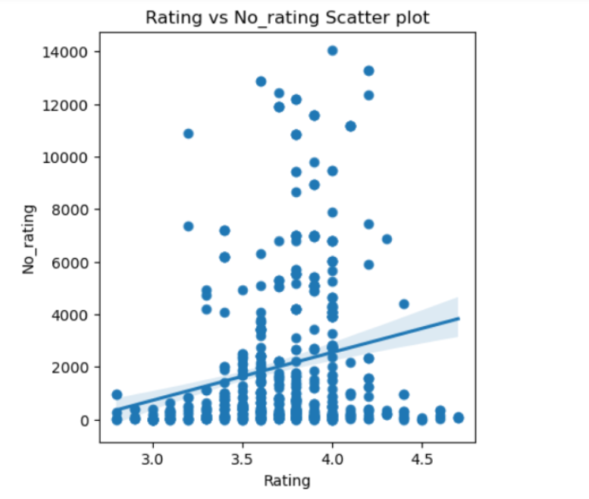
Bivariate Analysis on Num vs Num
Higher original price , higher discount price ,expensive products still stay expensive, even after discount.
There's a steady pattern between original and discounted prices.Most of the points fall near the trend line, meaning the price relationship is predictable and steady.
Higher ratings get more attention ,products with better ratings usually have more people rating them
Clear upward trend as the rating goes up, the number of ratings tends to go up too this shows a positive link between the two.

Slide 13
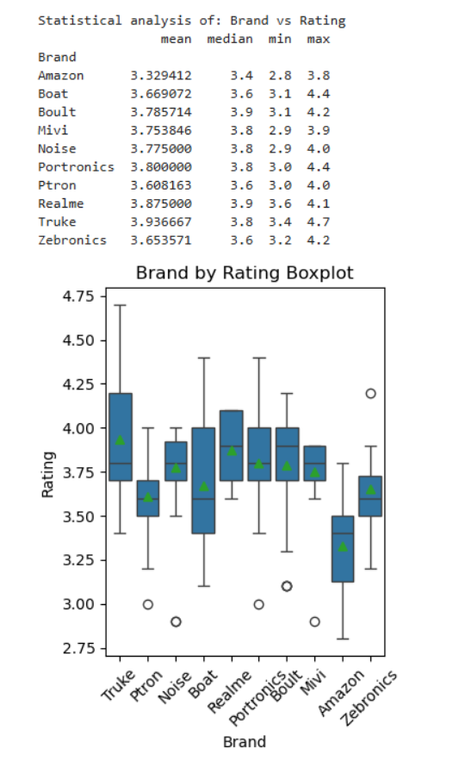
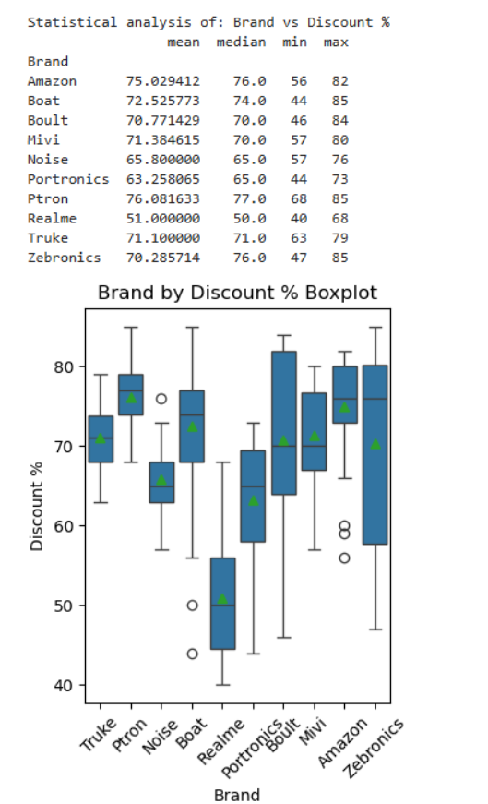
Bivariate Analysis on Cat vs Num
P tron and Amazon offer the biggest discounts on average, around 75–77%,
Realme gives the smallest discounts, with a median of just 50% much lower than the others. Brands like Mivi and Noise offers steady discounts
Top-Rated Brands Realme and Truke have the highest average ratings
Lowest-Rated Brand Amazon has the lowest average rating among all the brands Most brands have ratings between 3.0 and 4.5

Slide 14
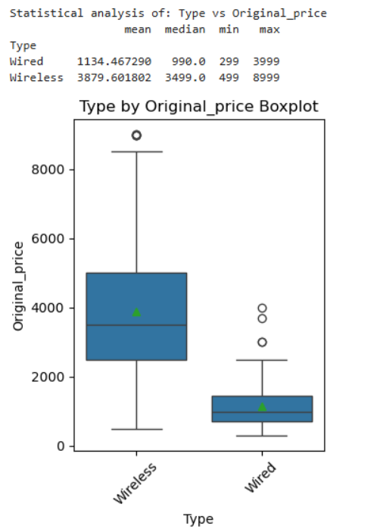
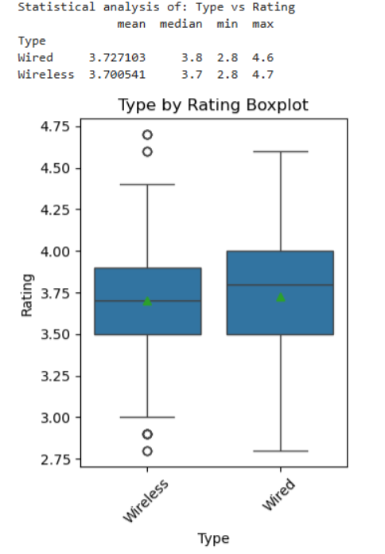
Wireless products have much higher average and median prices than wired ones.
Wireless items range from ₹499 to ₹8999, while wired items mostly stay between ₹299 and ₹3999.
Wired (3.72) and Wireless (3.70) products have almost the same average ratings.

Slide 15
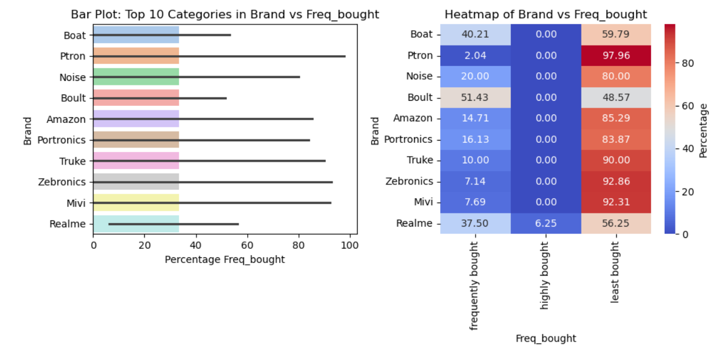
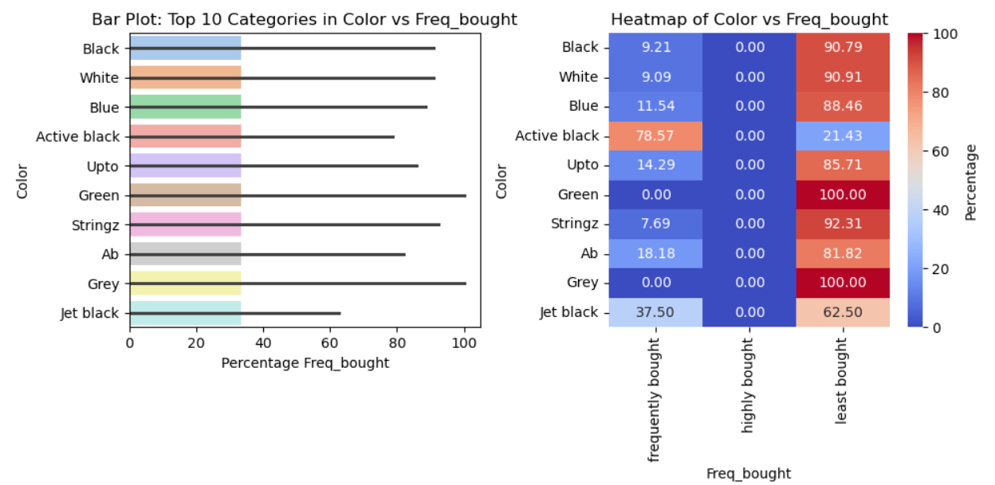
Bivariate Analysis on Cat vs Cat
P tron has the highest number of purchases
Boult is rarely chosen it has a very high percentage in the “least bought” group.The heatmap shows some are bought very often, others only a little.
Green and grey is the most frequently bought color among all. Low-demand colors jet Black and Black are the least prefered.

Slide 16
CONCLUSIONS
Wireless items are far more common and expensive than wired ones
Products with higher original prices tend to have higher discounted prices. Ptron and amazon offer the biggest discounts, while realme keeps its discounts low.
Boat dominates in popularity, while boult is most frequently purchased. Green and grey is the top color choice, and active black and black are least favored.
Ratings are mostly between 3.0 and 4.5, with wired and wireless products rated very similarly. Realme and truke are with higher average ratings
Higher-rated products attract more reviews, confirming that well-rated items tend to gain more attention.

Slide 17

THANK YOU

